Slide 1
How to Develop Training Videos for the IT Automation Term Project Using Adobe Captivate
Developed by Farhad Hemmati
Supervised by Dr. Masoud Sadjadi

Slide 2
Agenda
Getting Started
Recording Your First Video
Adding Your Voice

Slide 3
Download & Install
Before you start make sure that:
You have a valid Adobe ID; click here if you don’t.
Disable the pop-up blocker on your browser.
Turn off any firewall, antivirus, etc.
Make sure that you have Administrator privileges.
For best result use latest version of IE, Firefox, or Safari.

Slide 4
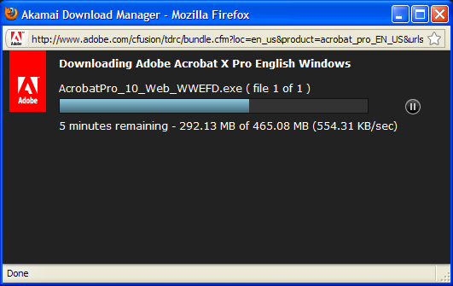
Download & Install
Go to the Download Page
Mouse over a featured product and choose Adobe Captivate 5.5 from all program dropdown menu and click GO.
Choose a language and platform from the Select pop-up menu, and then click Download Now.
If prompted, sign in with your Adobe ID and password.

Slide 5

Overview of the Process
There are four easy step in making a video with Adobe Captivate:

Slide 6
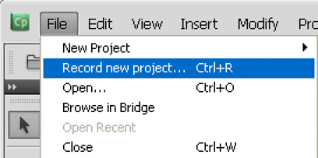
Recording
Open the application you want to demonstrate. For example If the video is about Kaseya, open Internet Explorer, go to the Kaseya VSA, and login.
Open Adobe Captivate.
In the main menu at the top of the Adobe Captivate window, select File and click Record New Project.

Slide 7
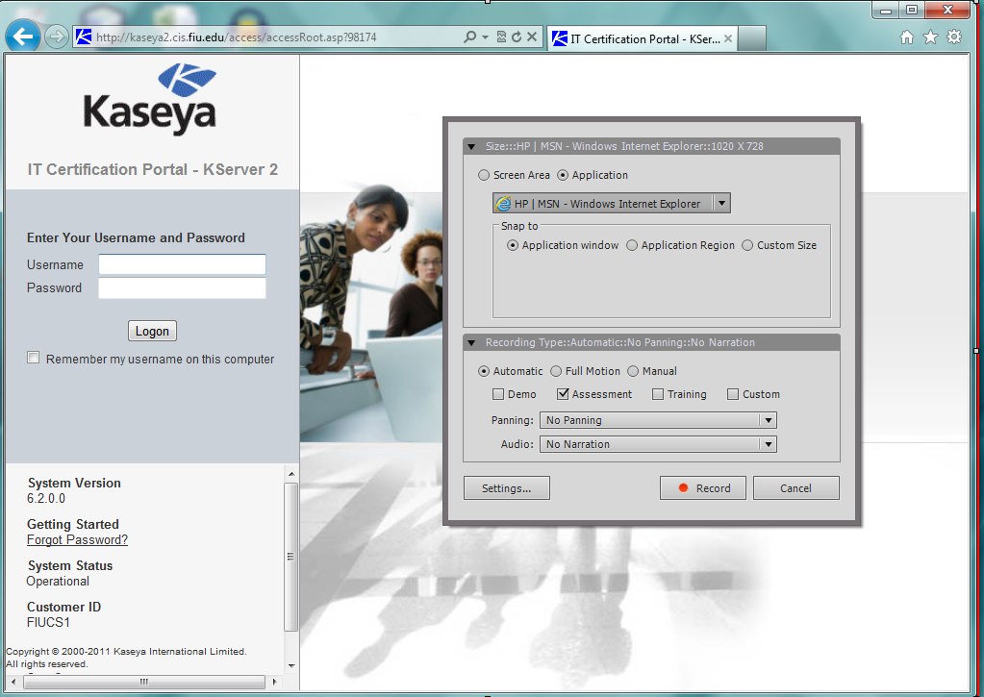
Follow the steps in the screenshot

Slide 8
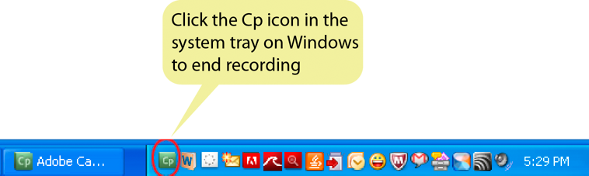
Recording Your First Video
Click Application and in the drop-down list , Click on Internet Explorer.
Click Record at the bottom of the screen
The countdown (from 3 to 1) for recording begins. At the end of the countdown Internet Explorer appears.
Now you see that the Adobe Captivate application is minimized and a screen with recording options appears
Perform the steps that you want to demonstrate in Internet Explorer or your chosen application.
After you are done click on Cp icon is the System tray to end recording

Slide 9
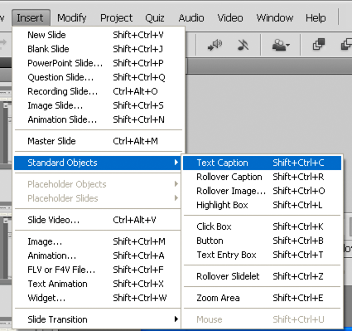
Edit
In the Filmstrip, click the slide on which you want to edit.
Under Insert tab > Standard Object you can see all the available options.
You may add a text caption, highlight box,…depending on your needs

Slide 10
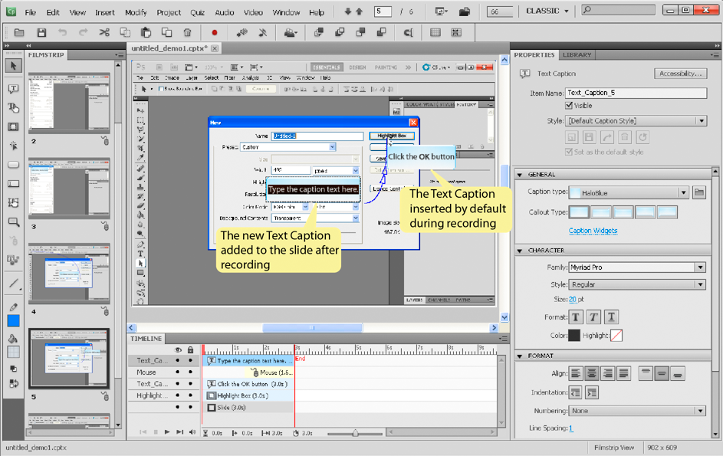
Edit
As it appears in the Screenshot
You also have all the options
On the left and properties of
Each object on the right.
You can ‘time’ the objects
so that they appear at
the required context when the
Adobe Captivate movie is played.
Using the time like on the bottom

Slide 11
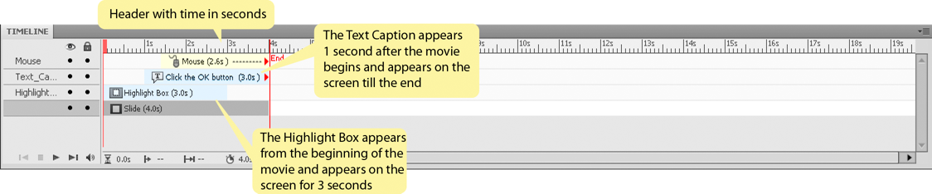
Adjusting the timeline
In the Timeline, click the horizontal bar that corresponds to the object.
Note: If the Timeline panel is not visible, click Windows > Timeline to open the panel.
To modify the start time of the object, hover your mouse over the left edge of the horizontal bar. When a double-headed arrow appears, click and drag the edge to the required position.

Slide 12
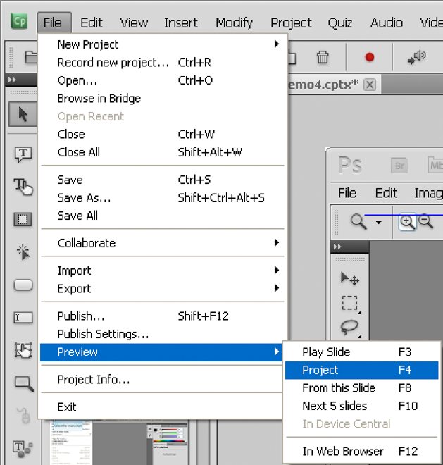
Preview
Preview helps you spot obvious gaps in workflows, slide transitions, timing of objects, and audio-slide or video-slide synchronization issues.
  In the main menu, click File > Preview.
  Select Project.
  After the preview, click ‘X’ at the right top corner to close the preview window and return to Adobe Captivate.

Slide 13
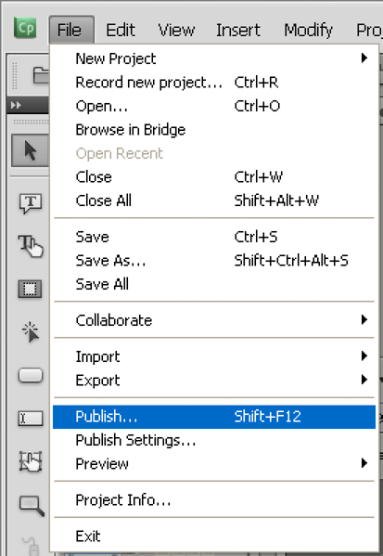
Publish
Save the project (File > Save).
Select File > Publish.
In dialog box, select Flash (SWF), and configure these:
Enter the project title.
Select the Publish to Folder check box.
Note: Ensure that the Export to HTML option is selected by default. This allows Captivate to create a JavaScript file for a browser view.
Publish continued…

Slide 14
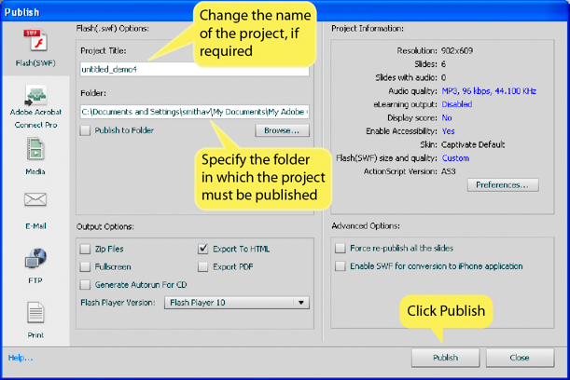
Publish
4. Click Publish.
Change the Flash player version to 9 or 10 depending on the version you have currently installed.

Slide 15
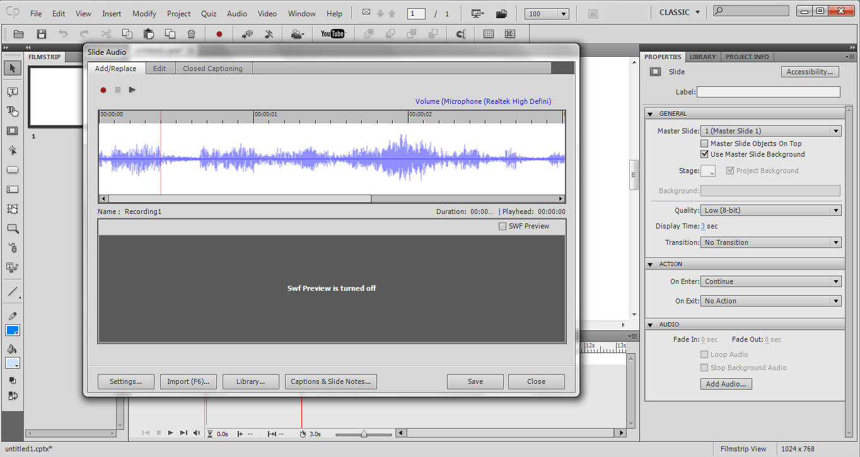
Voice over Slides
select Audio > Record to from the main menu
Click Record Audio icon to begin recording.
When you finish, click Stop Audio icon. The audio is converted to mp3 format.
Click Play Audio icon to listen to the recording.
If you want to add silence or adjust the volume for the audio file, use the options in the Edit tab to change the settings.
When you finish, click Save.

